Slide 1
Machine Learning & Deep Learning
Week-22_23
Instructor: Engr. Najam Aziz
National Center for Big Data & Cloud Computing (NCBC), UET Peshawar

Slide 2
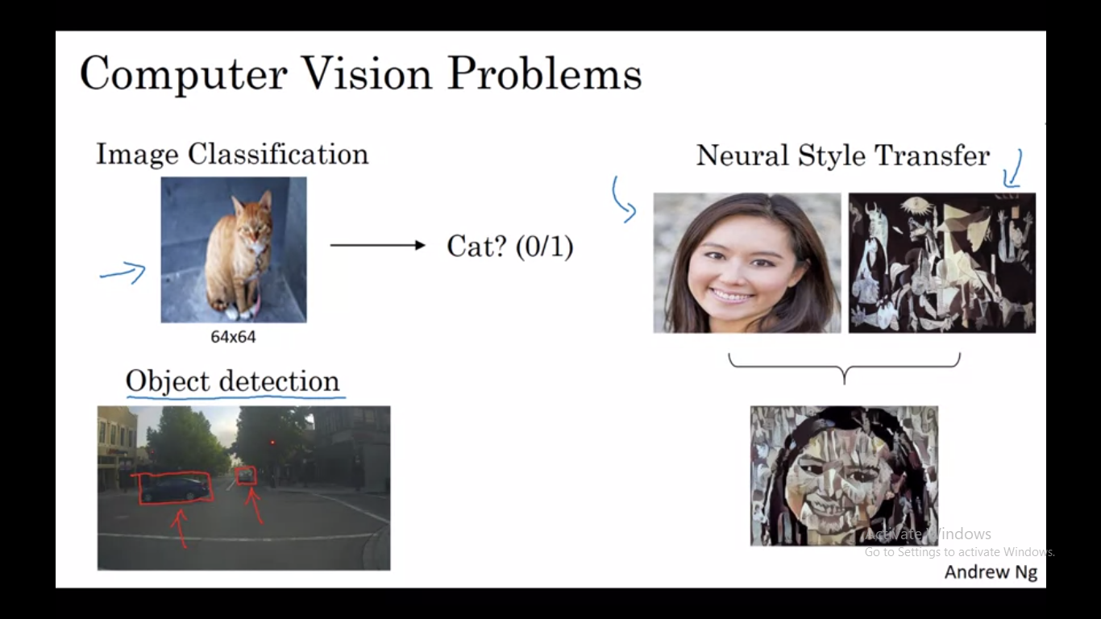

Slide 3
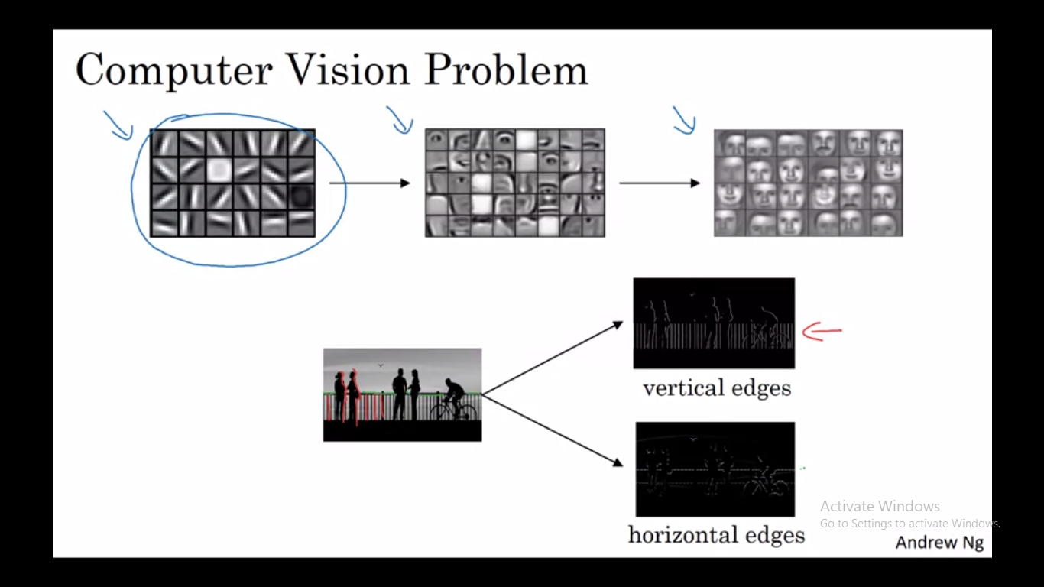

Slide 4
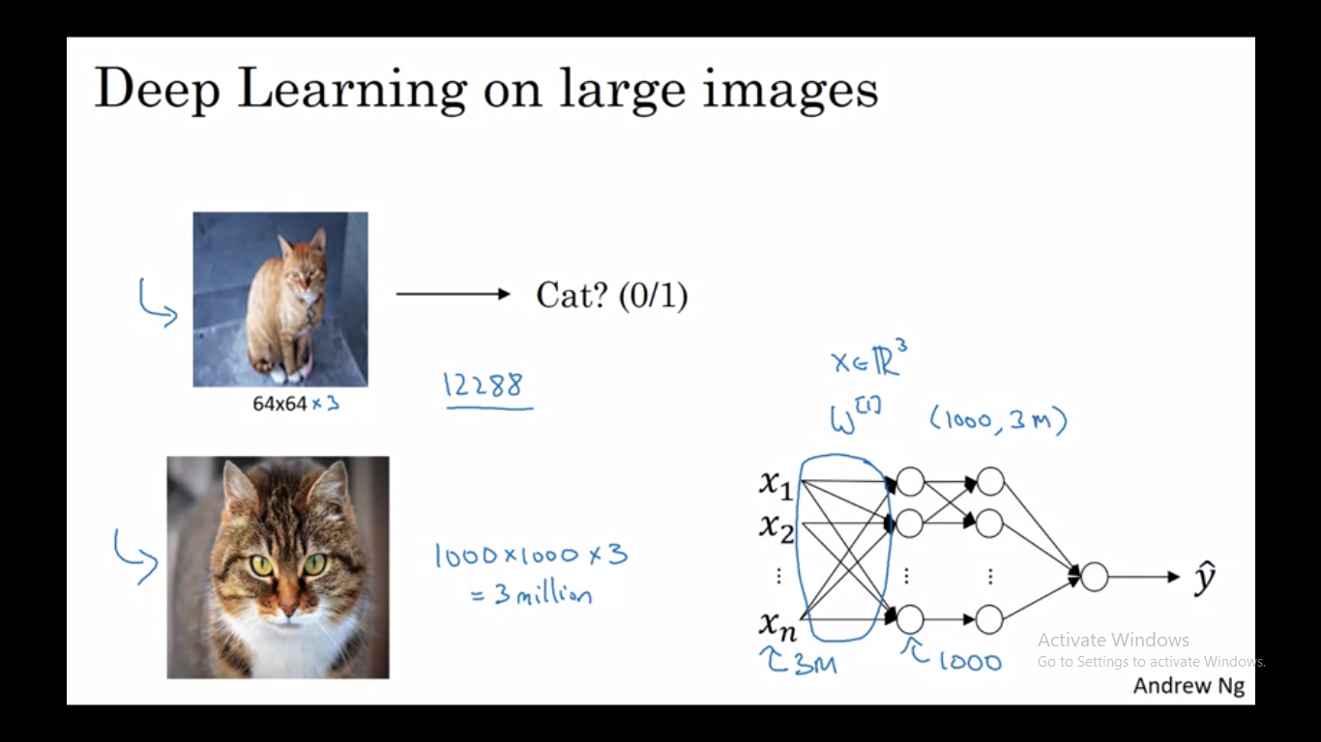

Slide 5
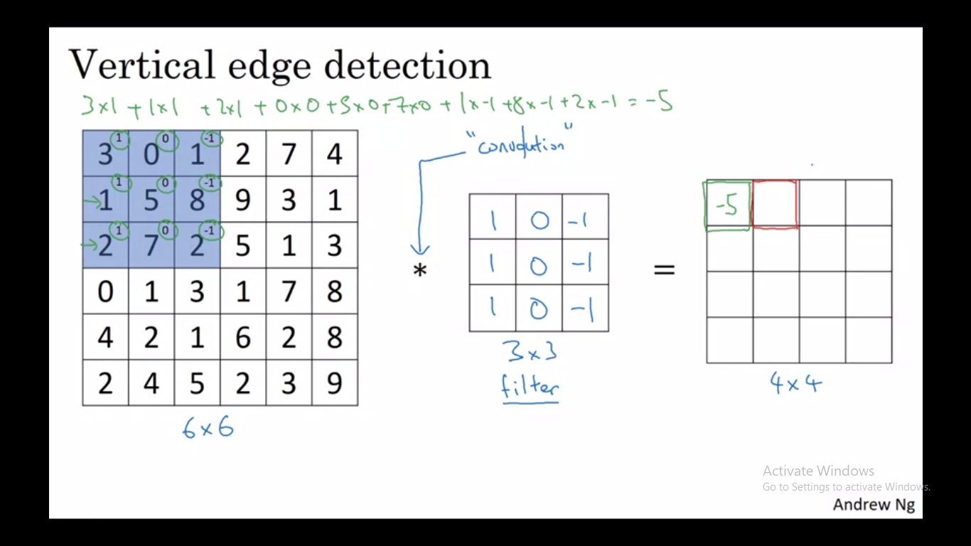

Slide 6
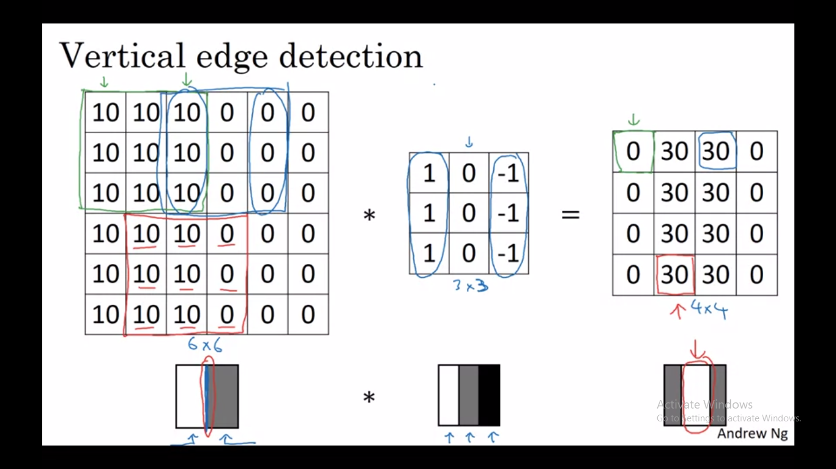

Slide 7
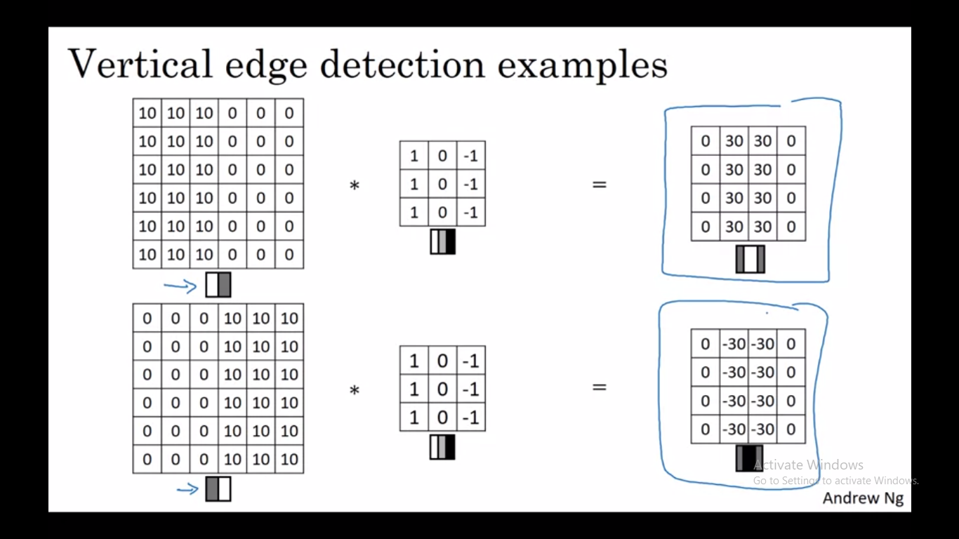

Slide 8
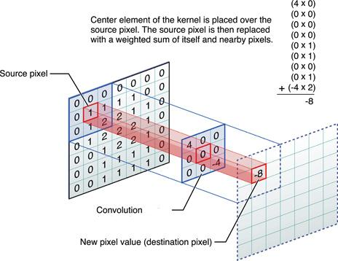

Slide 9
Filters/Kernel
Every layer of filters is there to capture patterns. For example, the first layer of filters captures patterns like edges, corners, dots etc. Subsequent layers combine those patterns to make bigger patterns (like combining edges to make squares, circles, etc.).
Now as we move forward in the layers, the patterns get more complex; hence there are larger combinations of patterns to capture. That's why we increase the filter size in subsequent layers to capture as many combinations as possible.

Slide 10
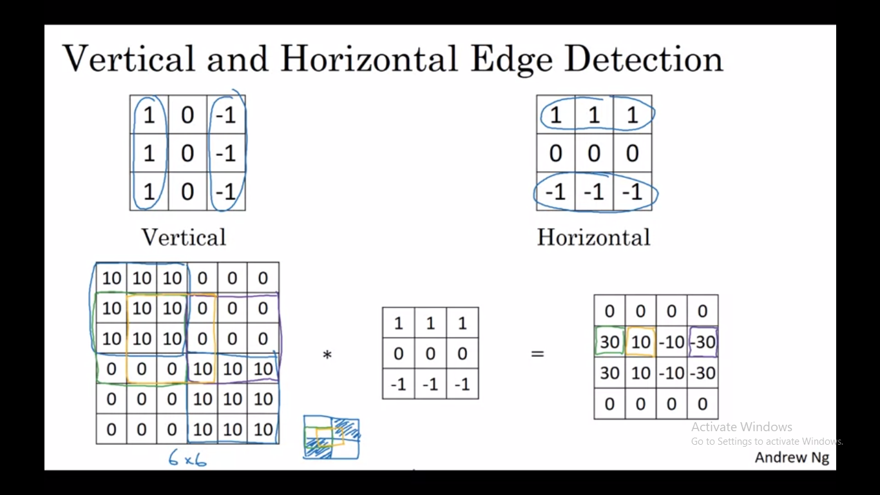

Slide 11
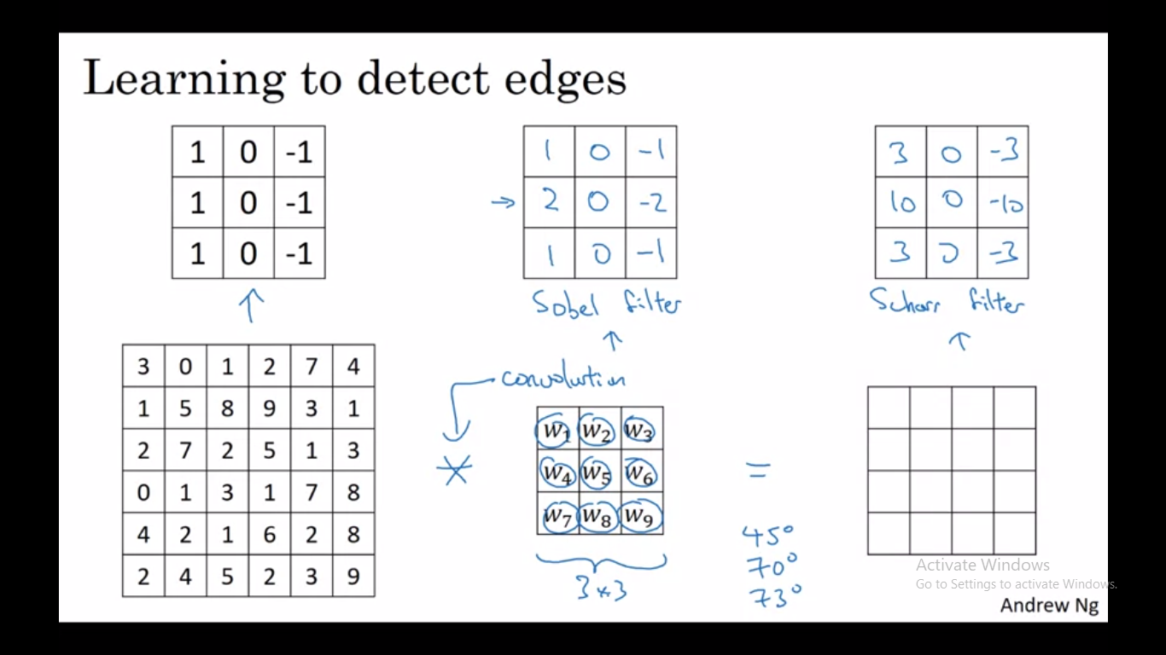

Slide 12
Padding
Downsides of Convolution:
Image shrinks, but sometime we don’t want to shrink it after every convolution or step. Bcoz in a very deep NN, the image will shrink to very small image.
The pixels on the corners or edges use much less in the output than the pixels at center. Which means throwing away lot of information near the edges of an image.
To solve both these problem, we need Padding.
In order to build deep neural network one modification to the basic convolutional operation that we need to really use, is padding. We pad the image before convolutional operation.

Slide 13
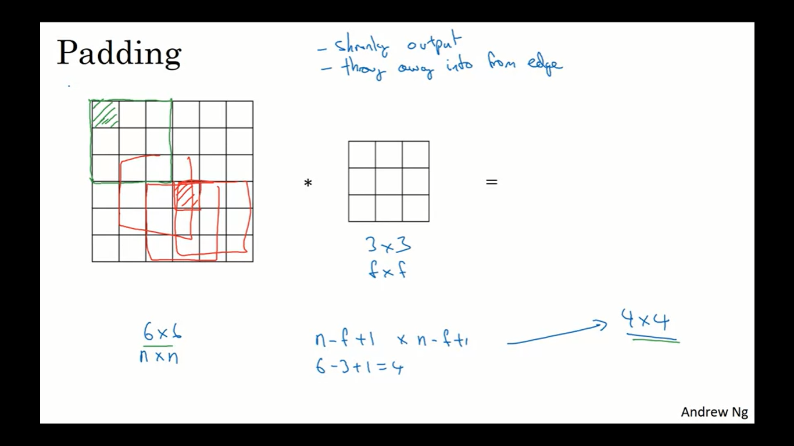
Downside of Convolution

Slide 14
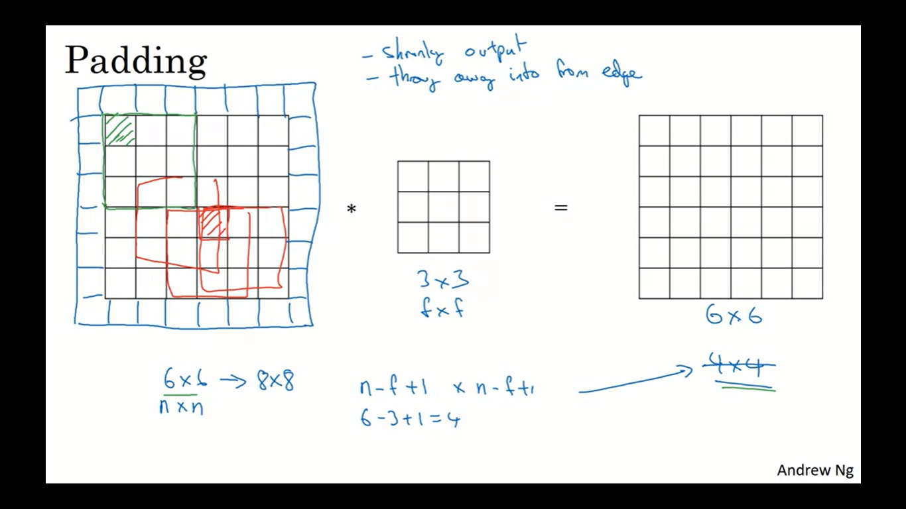

Slide 15
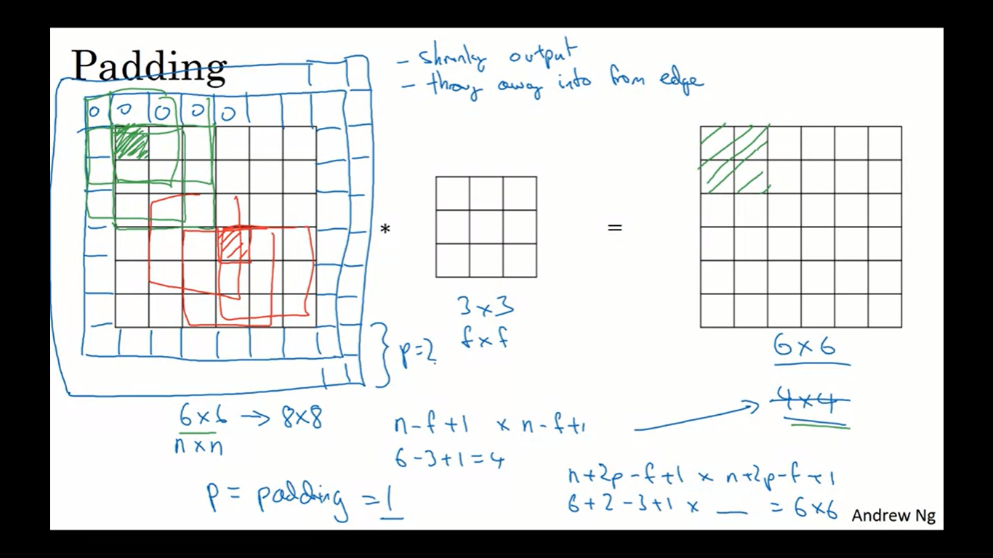

Slide 16
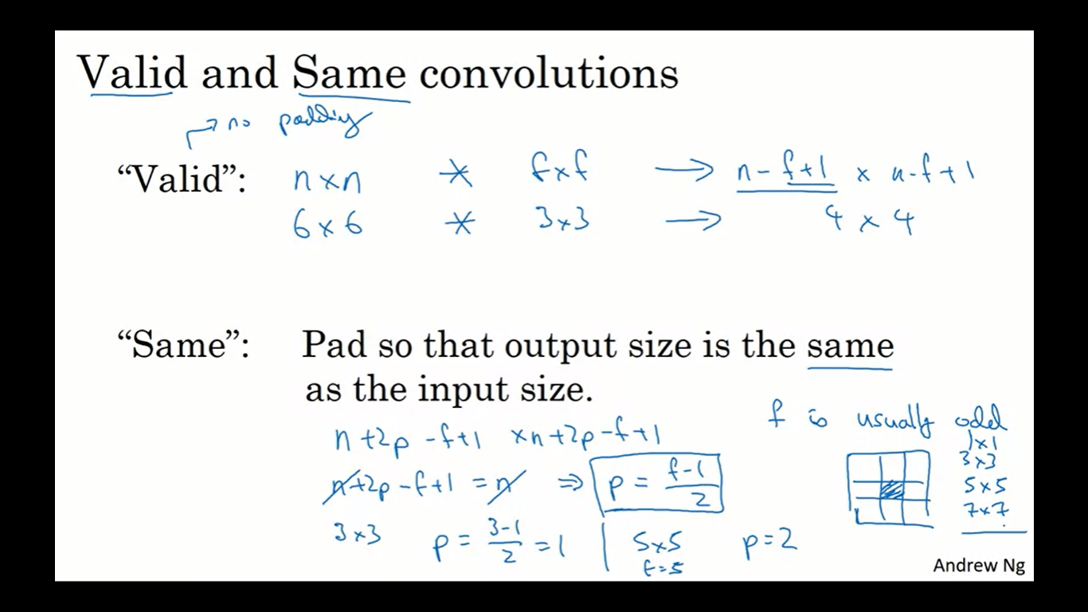

Slide 17
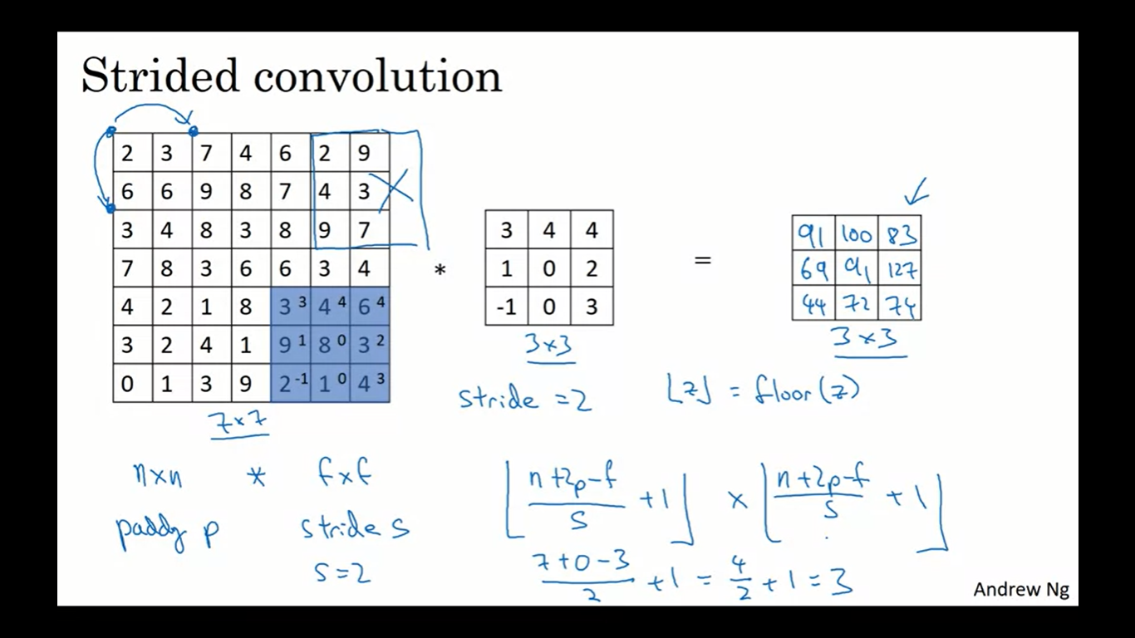

Slide 18
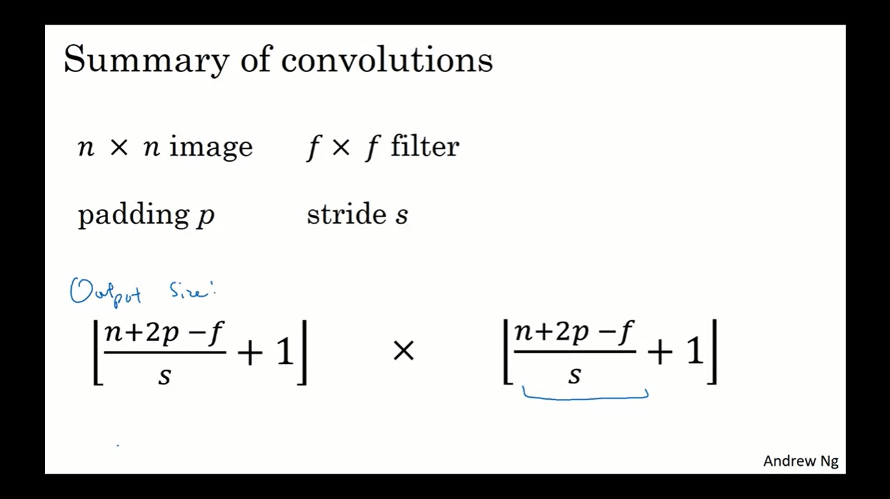

Slide 19
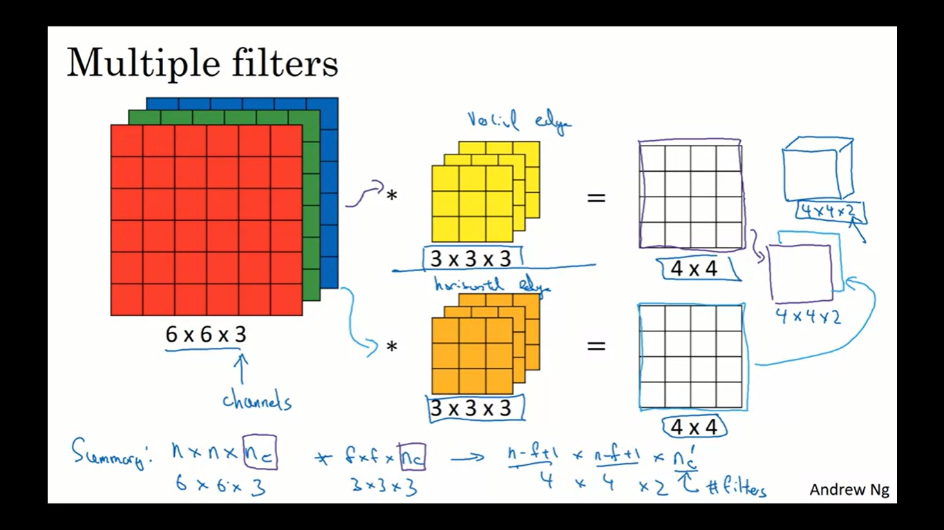

Slide 20
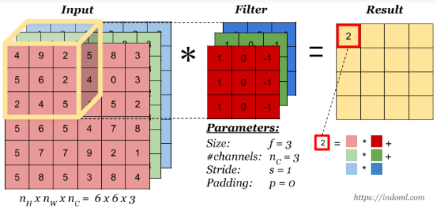
Convolution on RGB images

Slide 21
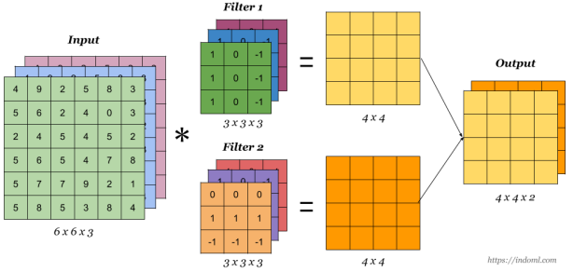
Convolution with multiple filters
27 Different/distinct parameters i.e. weights, from w1, w2, …, w27

Slide 22
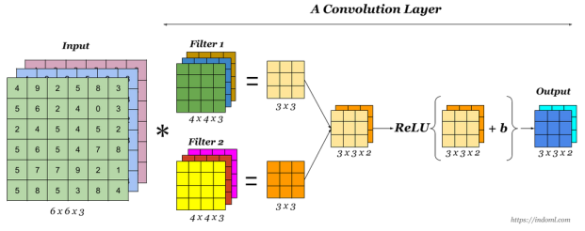
A Convolutional Layer

Slide 23
Limitation of the feature map output of convolutional layers
A limitation of the feature map output of convolutional layers is that they record the precise position of features in the input. This means that small movements in the position of the feature in the input image will result in a different feature map. This can happen with re-cropping, rotation, shifting, and other minor changes to the input image.
A common approach to addressing this problem from signal processing is called down sampling. This is where a lower resolution version of an input signal is created that still contains the large or important structural elements, without the fine detail that may not be as useful to the task.
Down sampling can be achieved with convolutional layers by changing the stride of the convolution across the image. A more robust and common approach is to use a pooling layer.

Slide 24
Pooling
A pooling layer is a new layer added after the convolutional layer. Specifically, after a nonlinearity (e.g. ReLU) has been applied to the feature maps output by a convolutional layer; for example the layers in a model may look as follows:
Input Image - Convolutional Layer - Nonlinearity - Pooling Layer
The pooling operation is specified, rather than learned. (Hence have No learnable parameters). It creates feature maps that summarize the presence of those features in the input. Two common functions used in the pooling operation are:
Maximum Pooling (or Max Pooling): Calculate the maximum value for each patch of the feature map. Average Pooling: Calculate the average value for each patch on the feature map.
The result of using a pooling layer and creating down-sampled or pooled feature maps is a summarized version of the features detected in the input.

Slide 25
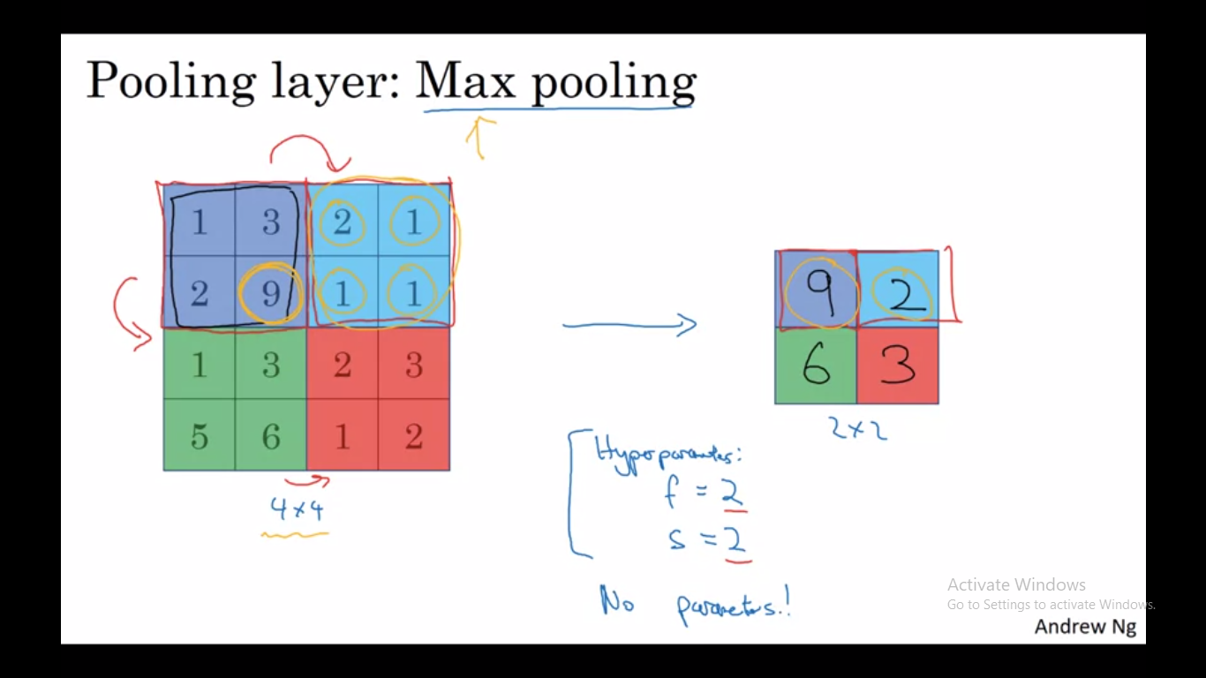

Slide 26
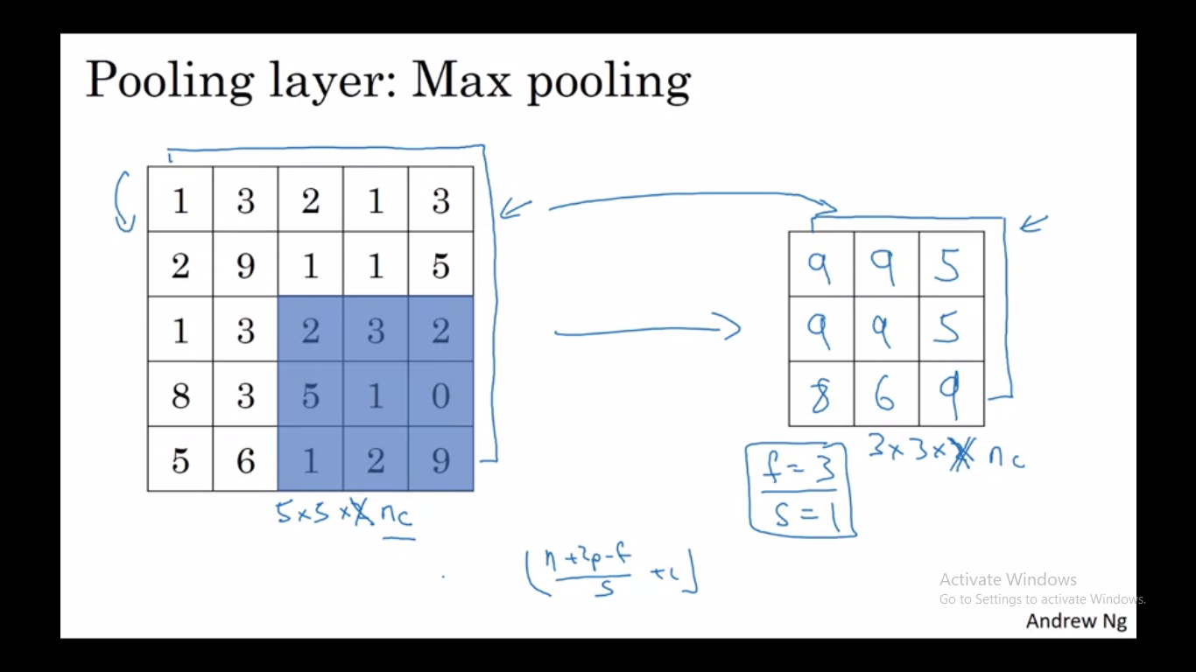

Slide 27
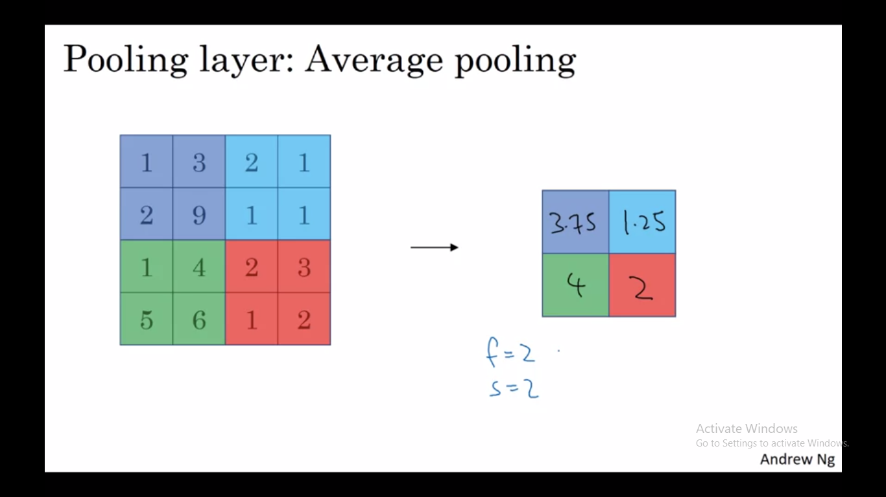

Slide 28
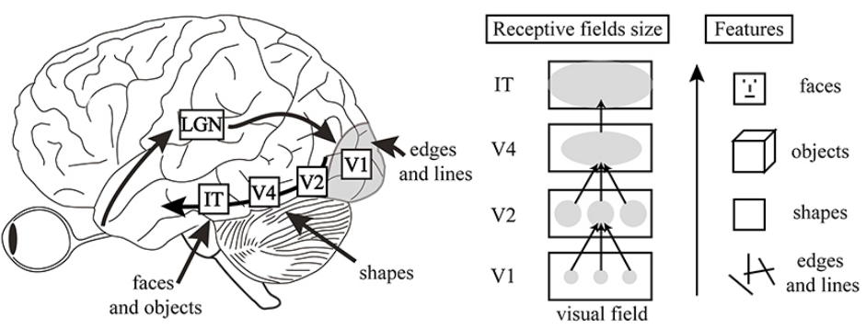
Human Visual Cortex

Slide 29


